Slide 1
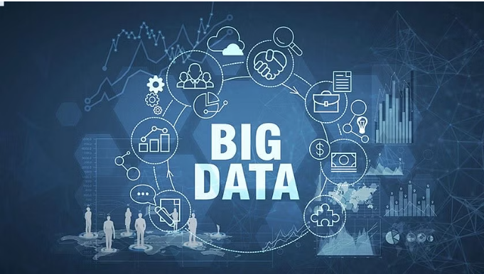
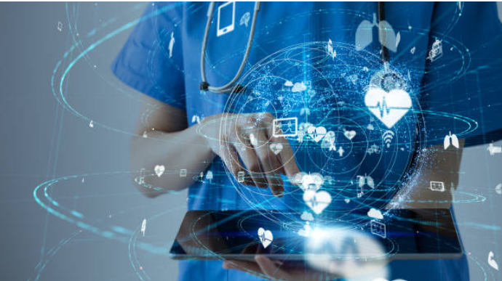
"Exploring the Power of Big Data in Healthcare: Use Cases and Advantages"
Presented by: Amrita Bhattacharya
Nancy Marian
Richa Sharma PG Diploma Data Science
Semester - 2
Professor: Mrs. Uma Yadav

Slide 2
The healthcare sector plays a vital role in society, providing essential services to individuals and communities.
Importance : The healthcare sector is critical for maintaining and improving the overall well-being of individuals.
Challenges : The healthcare sector faces several challenges, such as rising healthcare costs, an aging population, increased chronic diseases, access to quality care, data privacy concerns, and the need for efficient healthcare delivery systems.
Relevance in the business landscape : The healthcare sector represents a significant portion of the global economy and is continuously growing. It offers diverse opportunities for innovation, technological advancements.
Opportunities : The sector provides opportunities for advancements in medical research, personalized medicine, data-driven decision-making, remote healthcare delivery, telemedicine, and the integration of technology to improve patient outcomes

Slide 3
Big data refers to large and complex datasets that are generated from various sources within the healthcare sector. It is characterized by four main aspects: volume, velocity, variety, and veracity.
1. Volume - the vast amount of data generated and collected.
4. Veracity - the accuracy and reliability of data.
2. Velocity - the speed at which data is generated and processed.
5. Value - the meaningful insights and outcomes derived.
3. Variety - the diverse types and sources of data.
6. Validity - Ensures the accuracy and relevance of healthcare data for reliable decision-making.
The selection of which "V" to prioritize among validity, variability, and visualization depends on the specific objectives and requirements of the healthcare application or analysis being conducted.

Slide 4
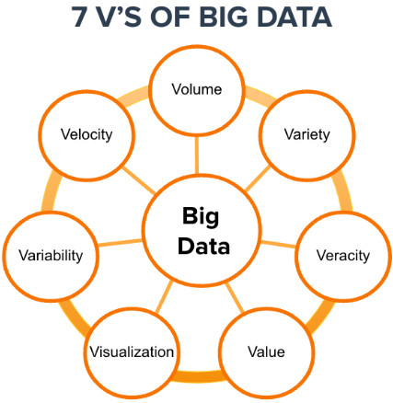
Volume:
Terabyte
Petabyte
Records
Transaction
Value:
Statistical
Hypothetical
Correlations
Modeling
Velocity:
Data-in-Motion
Data-in-Rest
Real-
time/offline
6 Vs of Big Data
Veracity:
Authenticity
Availability
Accountability
Trustworthine
Validity:
Correct Data
Incorrect
data
Variety:
Structured
Unstructured
Semi-Structured

Slide 5
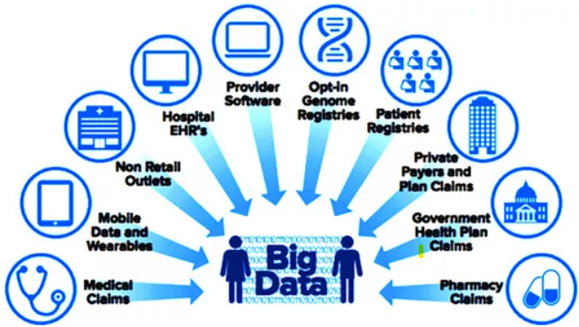
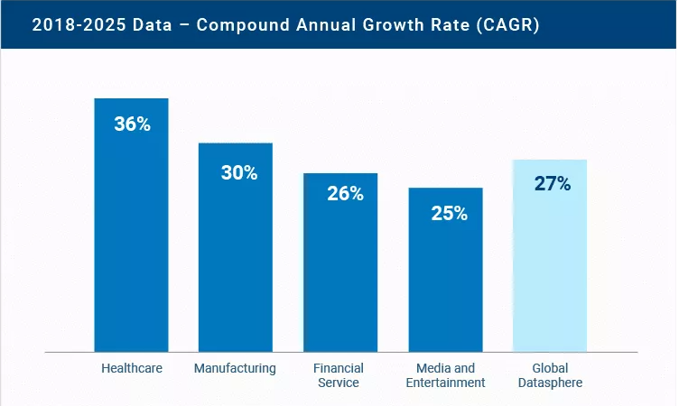
Business aspects of the healthcare industry
Representation of Big data in different Sectors

Slide 6
Key Applications of Big Data in Healthcare :
Predictive Analytics and Disease Prevention: Big data analytics uses patient health records, lifestyle data, and genetics to predict disease risk and preventions. Example: UCSF used big data to predict sepsis in ICU patients, enabling early intervention.
Healthcare Operations and Resource Optimization: Big data optimizes operations and resources for cost savings. Example: NewYork-Presbyterian analyzes real-time patient data to predict discharge times, reducing wait times.
Precision Medicine and Personalized Treatment: Big data analyzes genomics and patient data for personalized treatments. Example: NIH's All of Us program advances precision medicine through diverse genomic and health data.
Public Health Surveillance and Disease Outbreak Tracking: Big data monitors public health trends and tracks disease outbreaks. Example: Google's Flu Trends predicts flu activity using search query data, aiding early intervention by CDC.

Slide 7
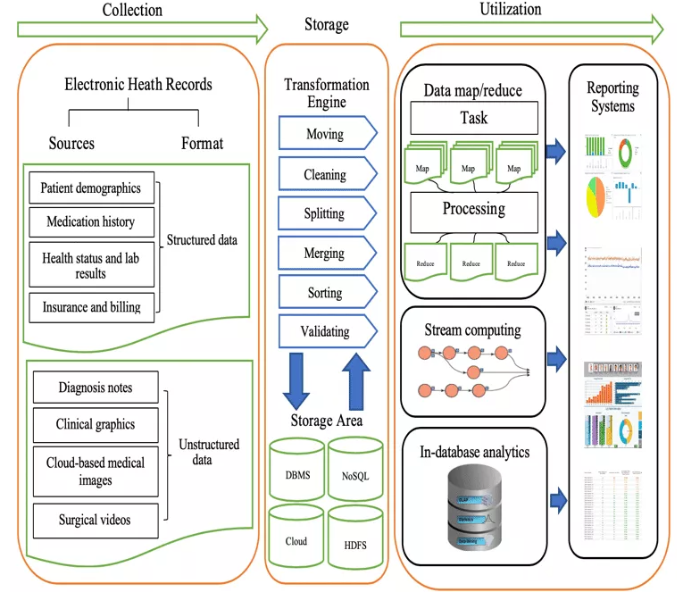
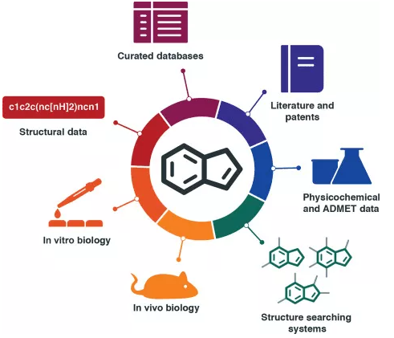
Some more applications are :
Big data analytics helps to manage electronic health records
In developing and discovering new drugs

Slide 8
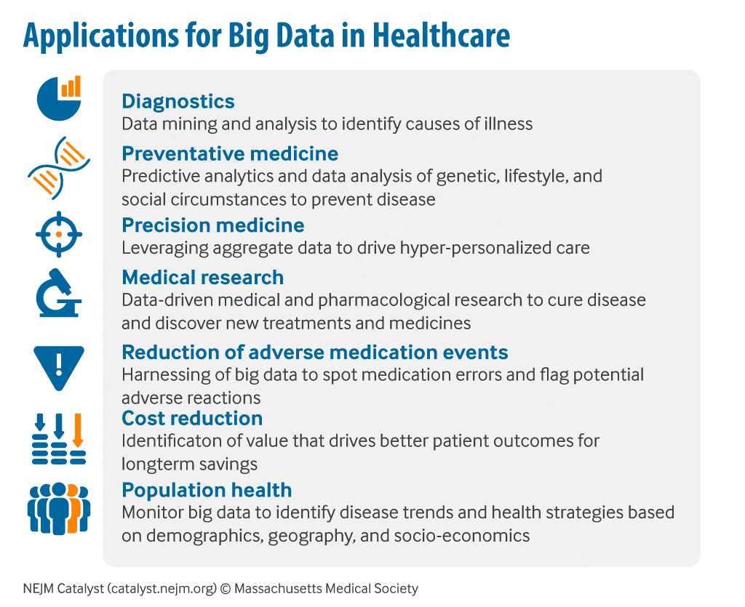
PROBLEM STATEMENT WITH ITS SOLUTION
Late diagnosis of diseases hinders effective treatment and increases costs. When diseases are identified late, it can become difficult to treat and control them effectively, leading to higher treatment costs and a decreased quality of life for the patient.
Use predictive analytics to identify patients at risk of developing certain diseases:
Predictive analytics is a data-driven approach that uses statistical algorithms and machine learning techniques to analyze healthcare data and predict patient outcomes, including the likelihood of developing certain diseases.
By using predictive analytics, healthcare providers can identify patients who are at risk of developing certain diseases even before they show any symptoms.

Slide 9
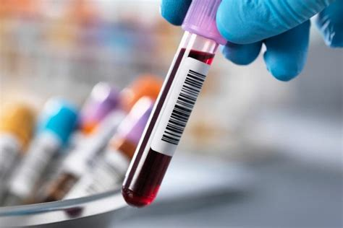
2. Traditional methods of disease detection are reactive rather than proactive.
Implement proactive screening and testing procedures to catch diseases early:
Early detection of diseases can make a big difference in patient outcomes, especially when it comes to severe conditions such as cancer or heart disease.
Proactive screening and testing procedures can help healthcare providers identify diseases in their early stages when they are more treatable and have a lower risk of complications.

Slide 10
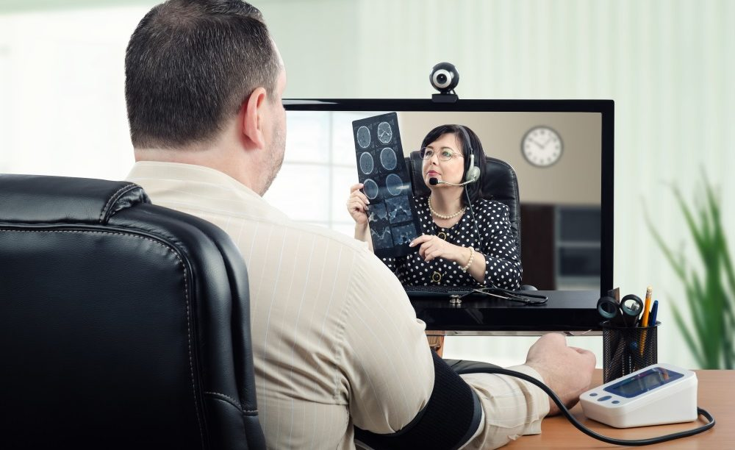
3. Limited access to healthcare in rural or lower-income areas can result in delayed diagnosis.
Use telemedicine or other technology to provide remote access to healthcare services:
Telemedicine refers to the use of telecommunication technologies to provide healthcare services remotely.
It enables healthcare providers to diagnose, treat, and monitor patients without requiring them to visit a physical clinic or hospital.
Telemedicine can be used for a range of services, such as consultations, health monitoring, or mental health counseling.

Slide 11
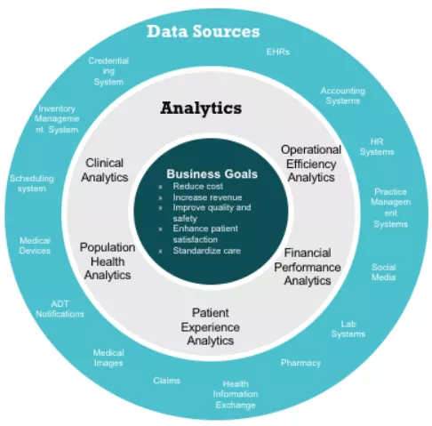
4. Large amounts of data are generated by healthcare systems, but this data is often not utilized effectively.
Utilize machine learning algorithms to analyze large amounts of healthcare data and identify patterns that may indicate the presence of a disease:
Machine learning is a subset of artificial intelligence that enables computers to learn from and make predictions based on large amounts of data.
Healthcare providers can use machine learning algorithms to analyze vast amounts of healthcare data, such as EHRs, medical images, or patient-generated data from wearable devices.

Slide 12
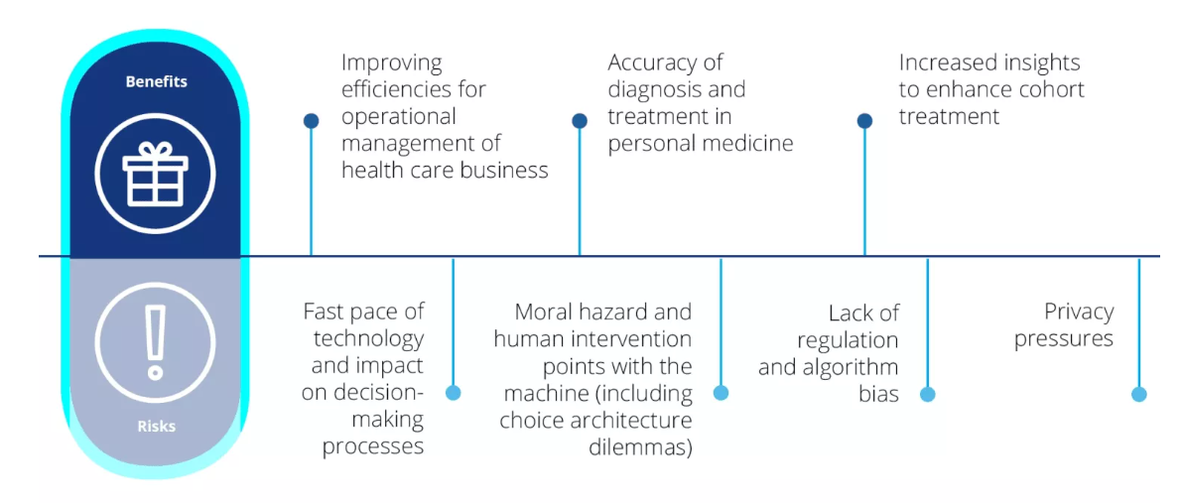

Benefits:
Improved Treatment Outcomes
Cost Savings
Enhanced Quality of Life
Prevention and Risk Reduction
Public Health Impact
Research and Data Insights

Slide 13

Conclusion:
Early disease detection is crucial for improving patient outcomes, reducing healthcare costs, and enhancing public health. By leveraging advanced technologies and proactive screening programs, we can identify diseases at their early stages and intervene promptly. This leads to better treatment outcomes, cost savings, and improved quality of life for patients.
Early detection enables targeted preventive measures, personalized interventions, and risk reduction strategies, ultimately reducing the incidence of diseases. Implementing early detection programs on a larger scale benefits both individuals and public health by enabling disease surveillance and informing preventive strategies. The data generated through these programs also supports medical research and advancements in healthcare practices. Overall, early disease detection is a transformative approach that emphasizes prevention and proactive healthcare, contributing to a healthier society.

